Slide 1

Smart Workforce Tracker
Mentor : Dr.K.Suriyakrishnaan
Student : V. Akshay
Dept : ECE

Slide 2
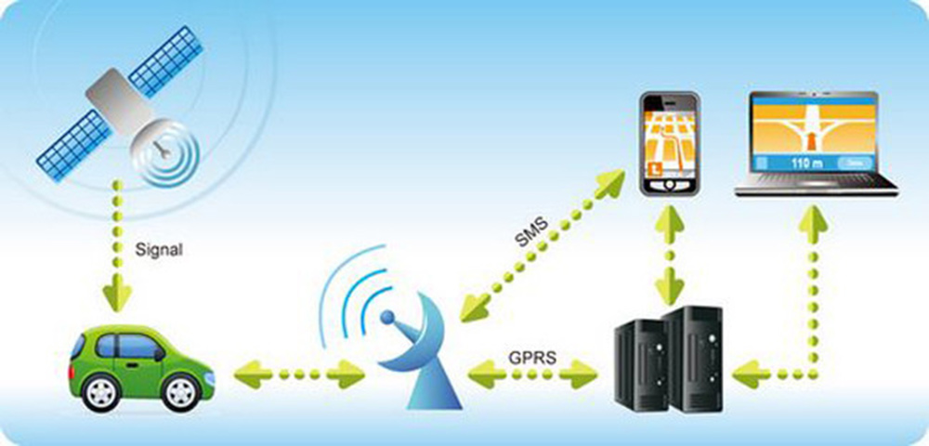
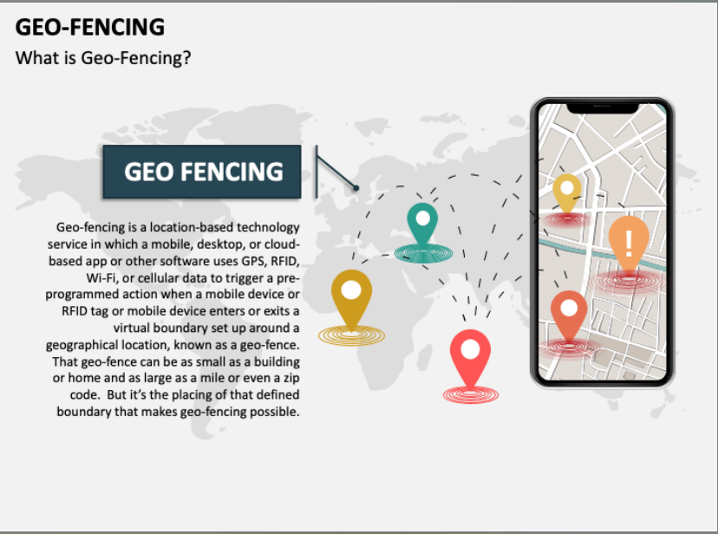
Smart Workforce Tracker

Slide 3
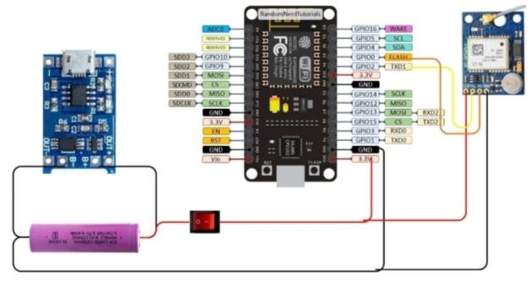
Architecture Diagram for Smart Workforce Tracker /GPS Systems Phase I

Slide 4
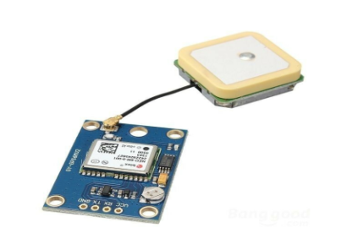

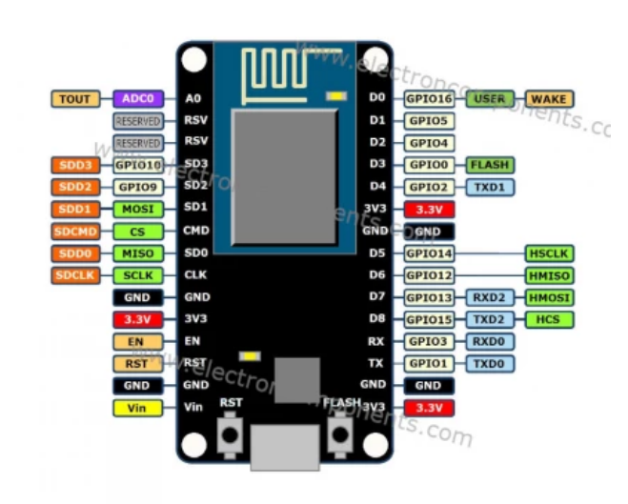
Description
Smart Workforce Tracker system uses the GPS signals from the tracking device to pinpoint the location and marks the limits of an area of Workers. This is the Smart Workforce Tracker.
A Geofence is a virtual fence or an imaginary border drawn around a point by a GPS tracking system. Once a Geofence is created, it can be used as a trigger for alerts and events.
Components: Node MCU, Neo 6M GPS Module, and the buzzer.
Node MCU Neo 6M GPS Module Buzzer Components requirement
GPS module – 1
Node MCU
On off switch – 1
12v adaptor – 1

Slide 5
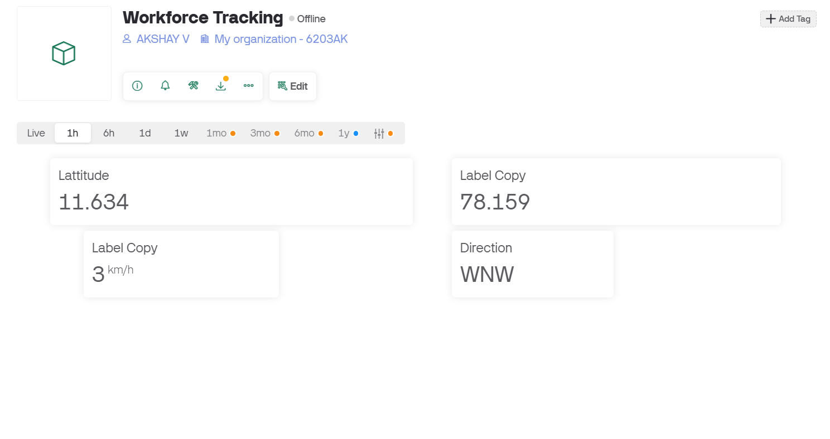
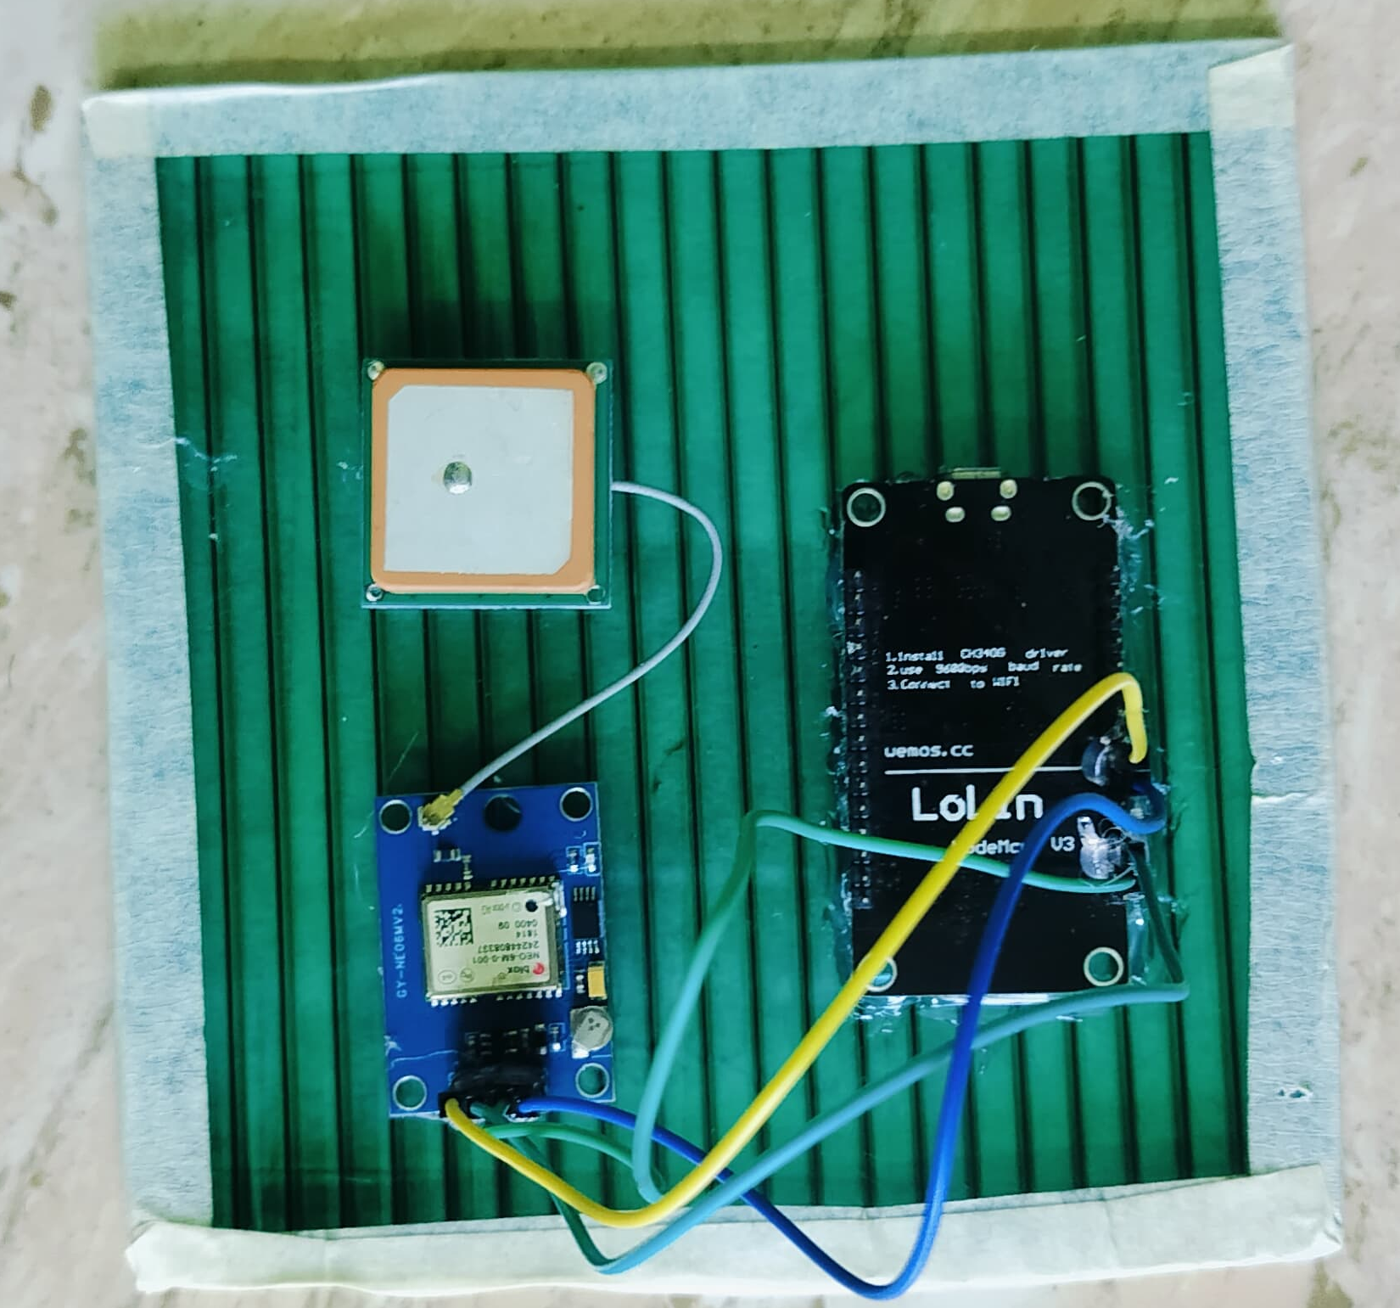
Snapshots & Output of our Prototype Model Phase 1
Latitude & Longitude Measurement’s
Connection Layout

Slide 6
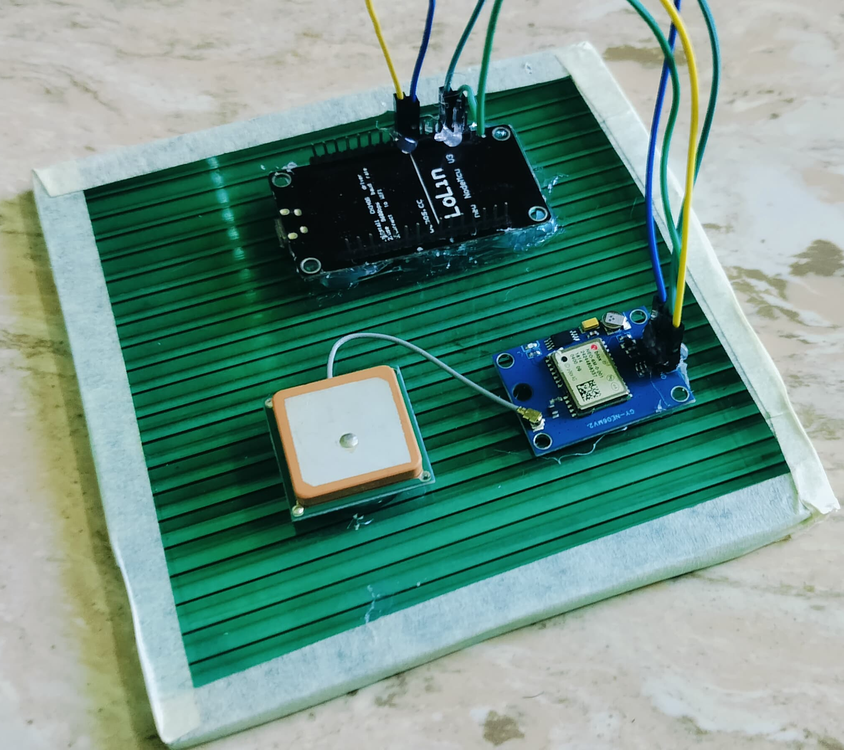
Snapshots & Output of our Prototype Model Phase I

Slide 7
Snapshots & Output of our Prototype Model Phase I

